Slide 1
Please feel free to use these images in slides or documents to show receiver buoys and/or tags
Photos take by: Joanne Jarzobski

Slide 2
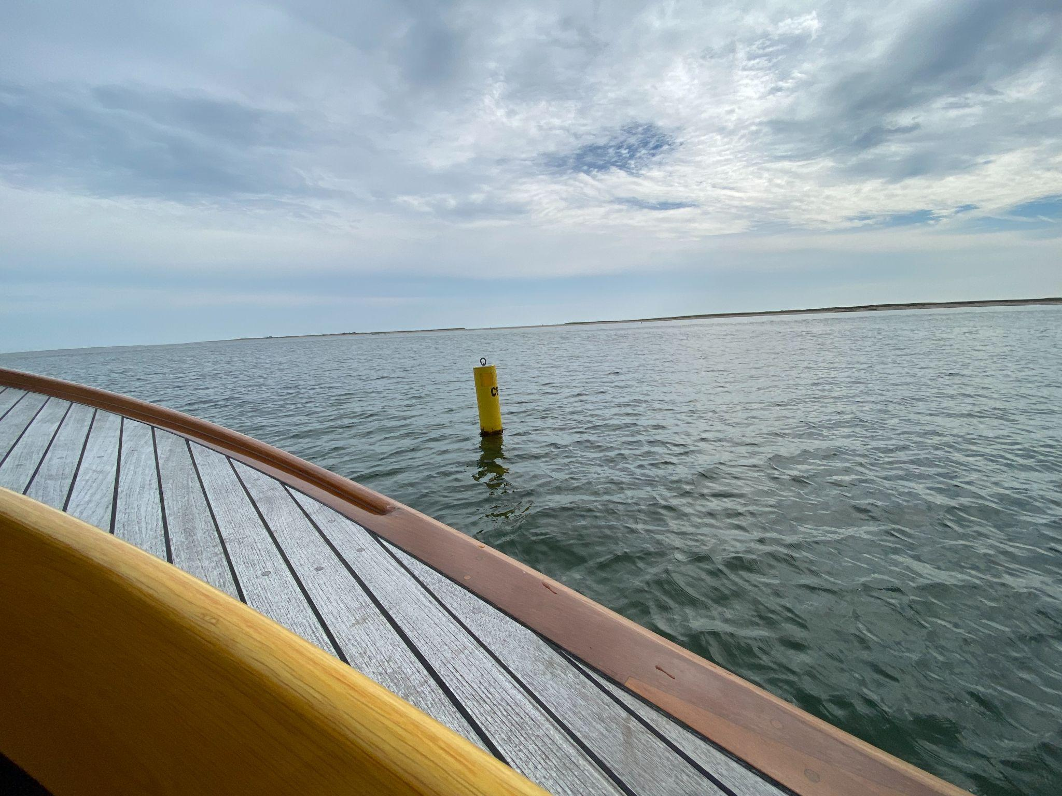
Notes:
This is a receiver, this one is located in Chatham

Slide 3
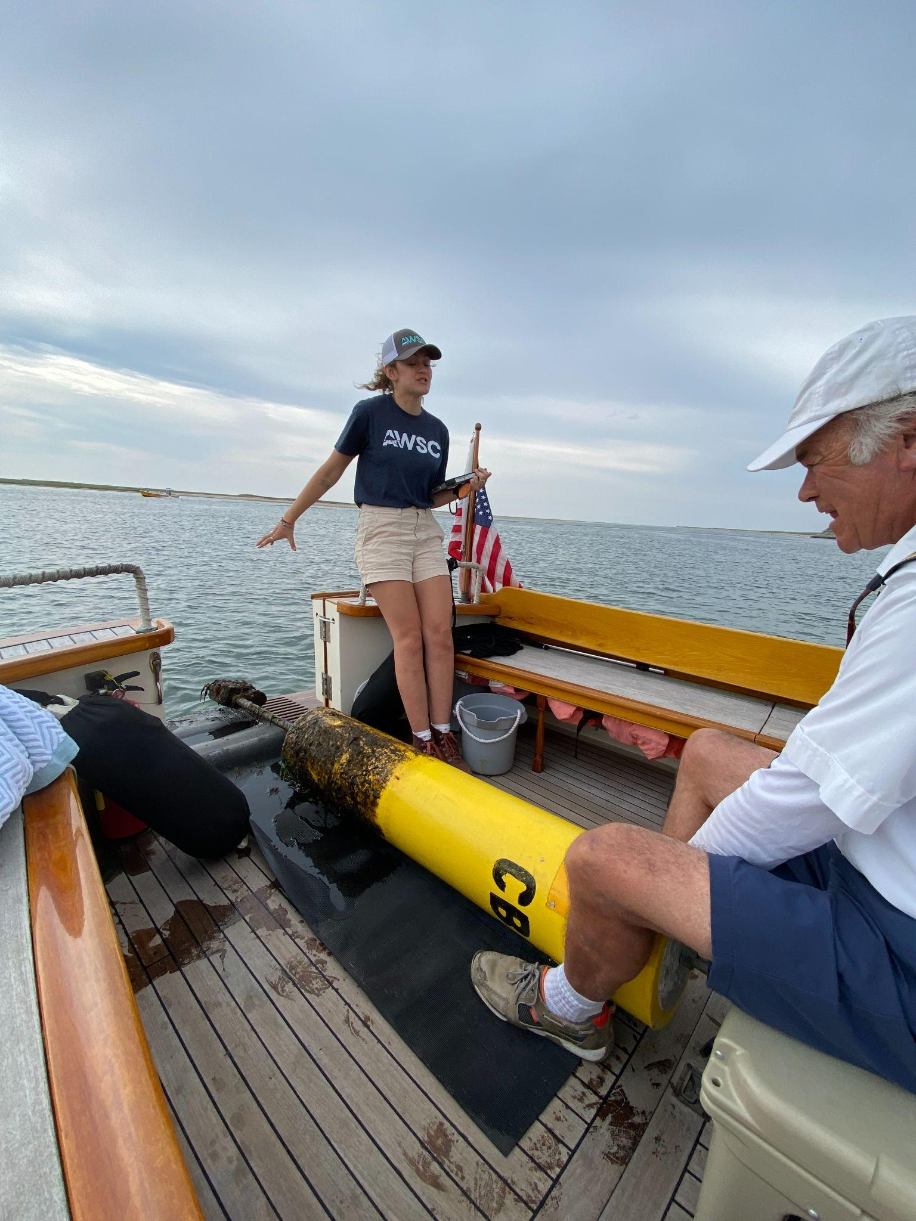
Notes:
Receiver out of water

Slide 4
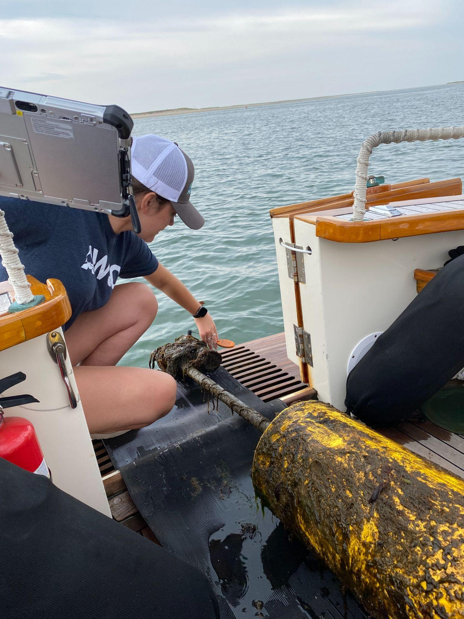
Notes:
Receiver out of water and reading the data off of it onto the ipad

Slide 5
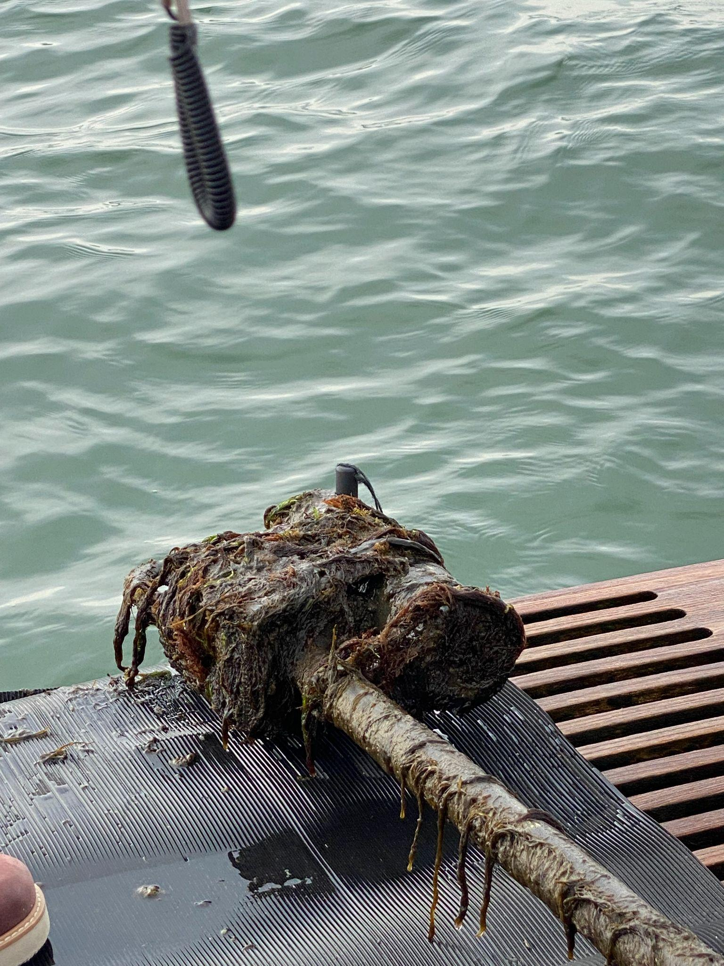
Notes:
Receiver recorder part covered with ocean material

Slide 6
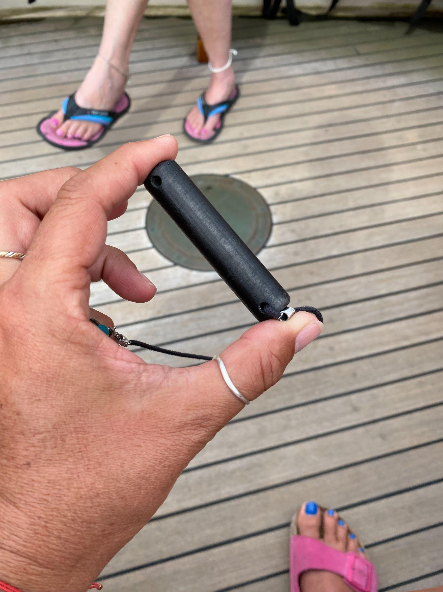
Notes:
Tag

Slide 7
