Slide 1
"Images and material for this lesson were created using research and images from the Atlantic White Shark Conservancy"

Slide 2
Individual Sharks and Answer Key
Tom brady slide 3 and 4
Big papi slide 5 and 6
Large marge slide 7 and 8
Jamison slide 9 and 10
Jellybean slide 11 and 12
Turbo slide 13 and 14
Sharkuterie slide 15-17
Notes:
Please note, I have inverted images so the dorsal fin is facing the same direction BUT you can do this with rights and lefts by screenshotting the images from the logbook and inserting them here. I also made all images black and white so it was easier to print. I would letter the images A, B, C, etc so you can talk about them easier when Identifying them and which go together (maybe mix up how you letter them so they aren’t together). You can also go to the AWSC logbook and do the rights and left dorsals in color (screenshot, crop). I have included a handout/worksheet, but you could do this verbally and tally it on the board, or use sticky notes and have kids put which are matches on a gallery walk, there are several ways you could use this assignment and materials–personalize and make it your own as you desire/need.

Slide 3
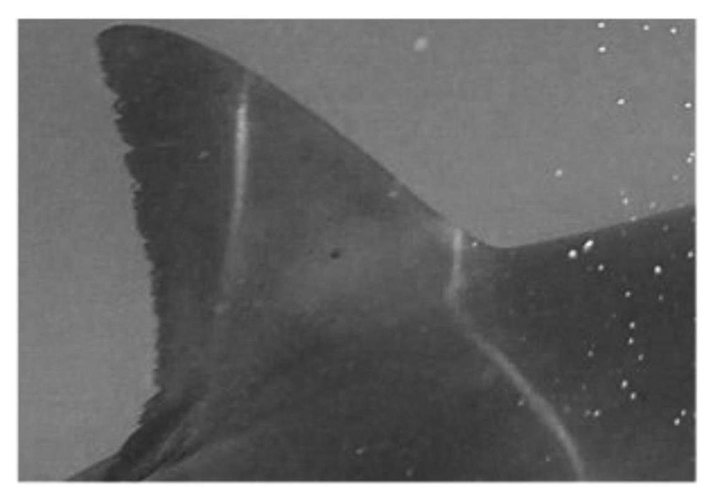
Notes:
BRADY

Slide 4
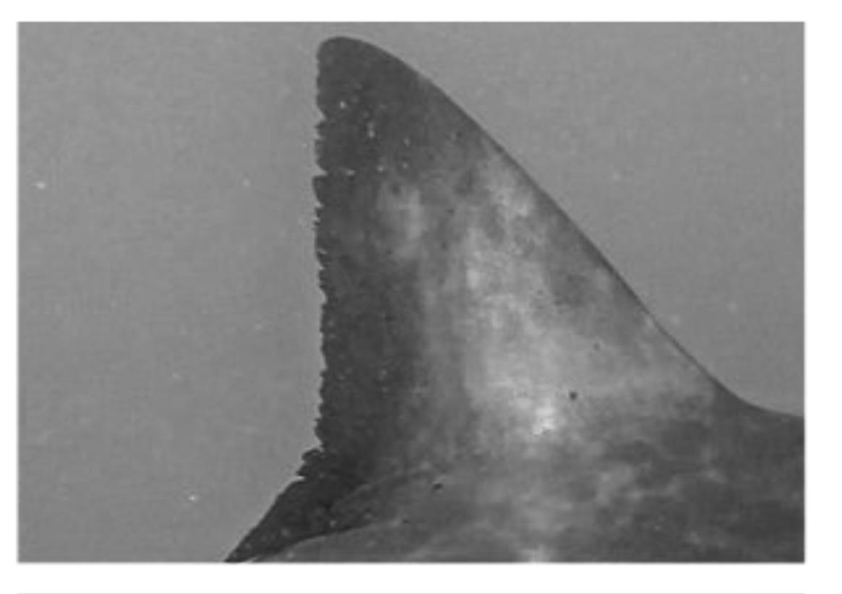
Notes:
BRADY

Slide 5
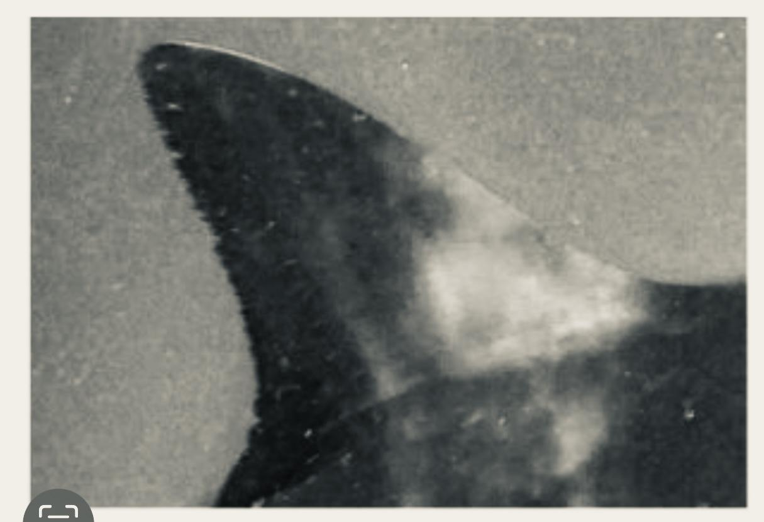
Notes:
BIG PAPI

Slide 6
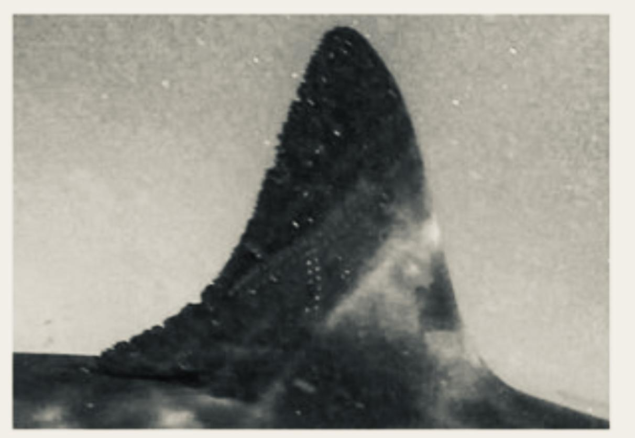
Notes:
BIG PAPI

Slide 7
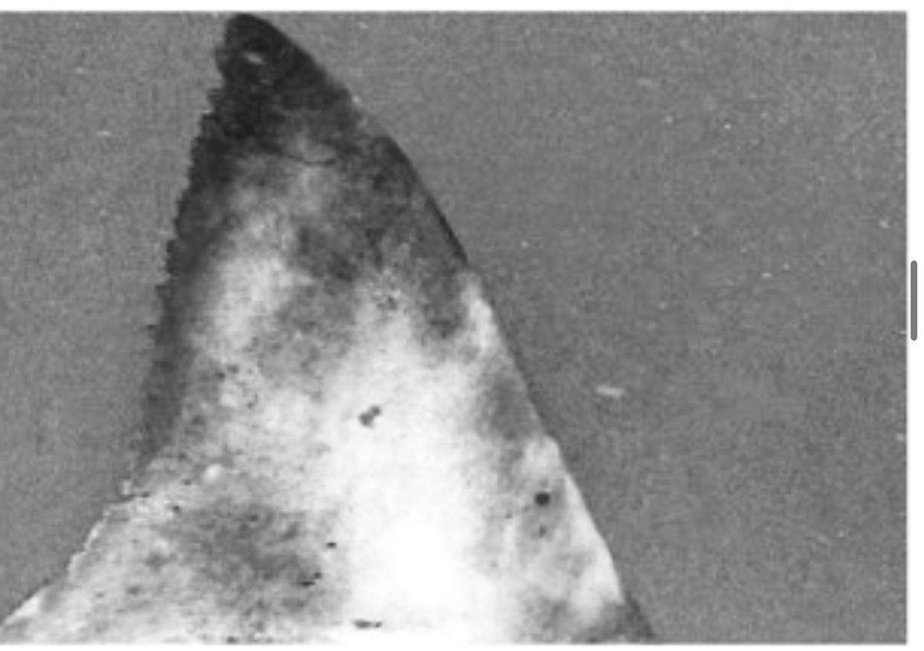
Notes:
LARGE MARGE

Slide 8
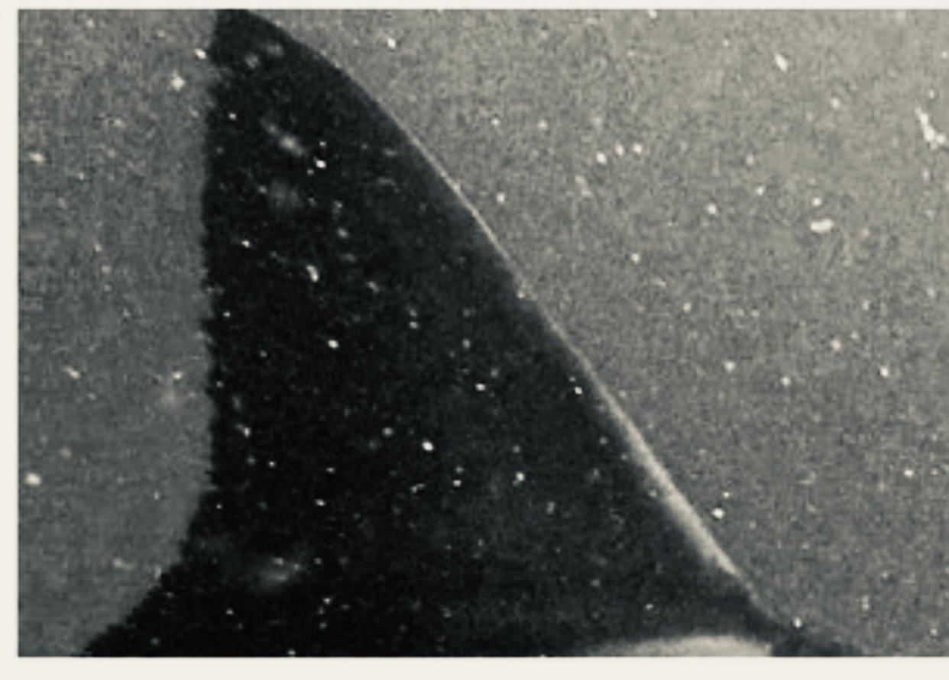
Notes:
LARGE MARGE

Slide 9
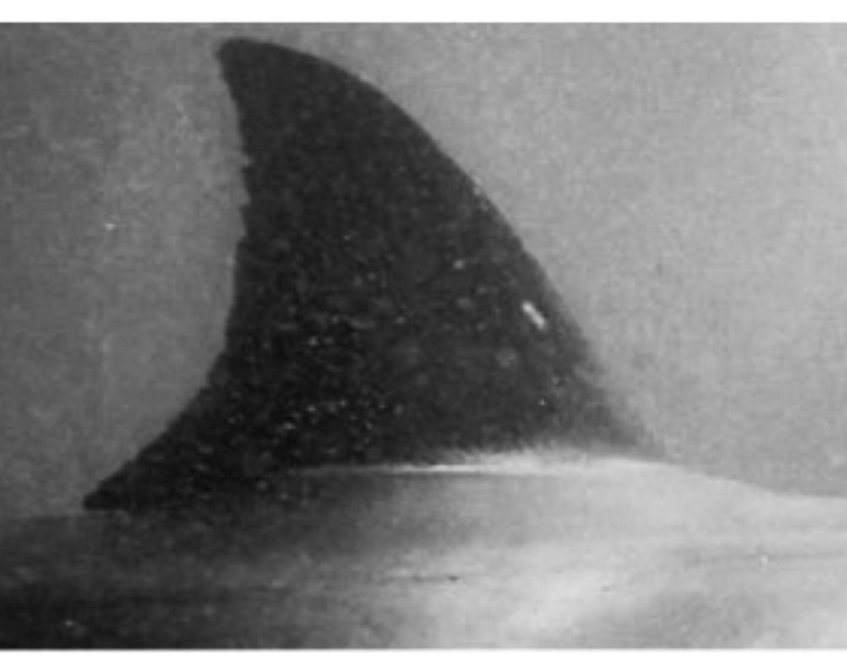
Notes:
JAMISON

Slide 10
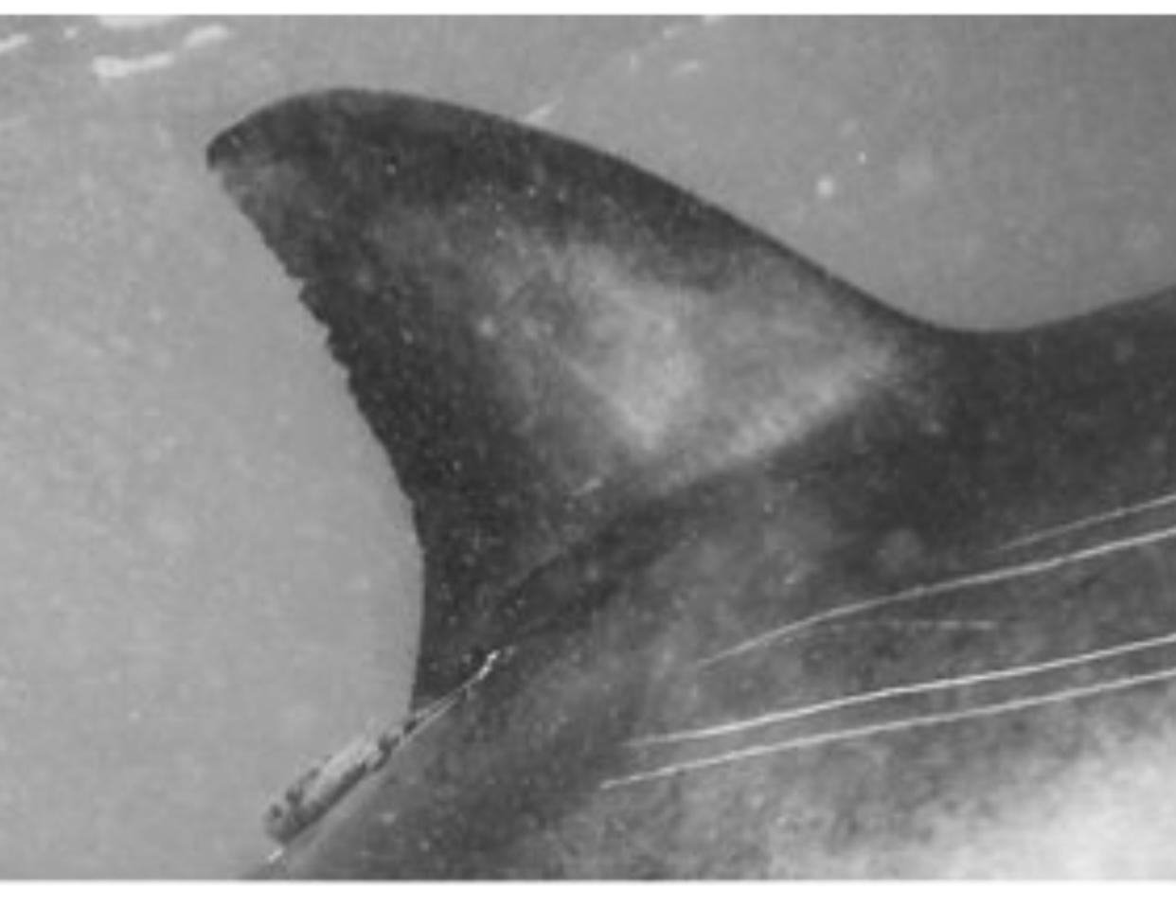
Notes:
JAMISON

Slide 11
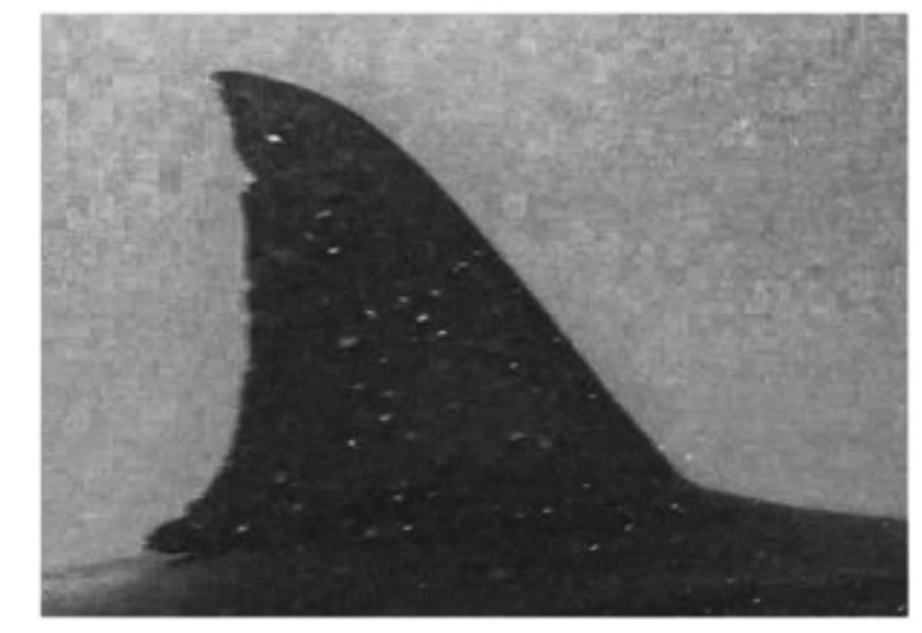
Notes:
JELLYBEAN

Slide 12
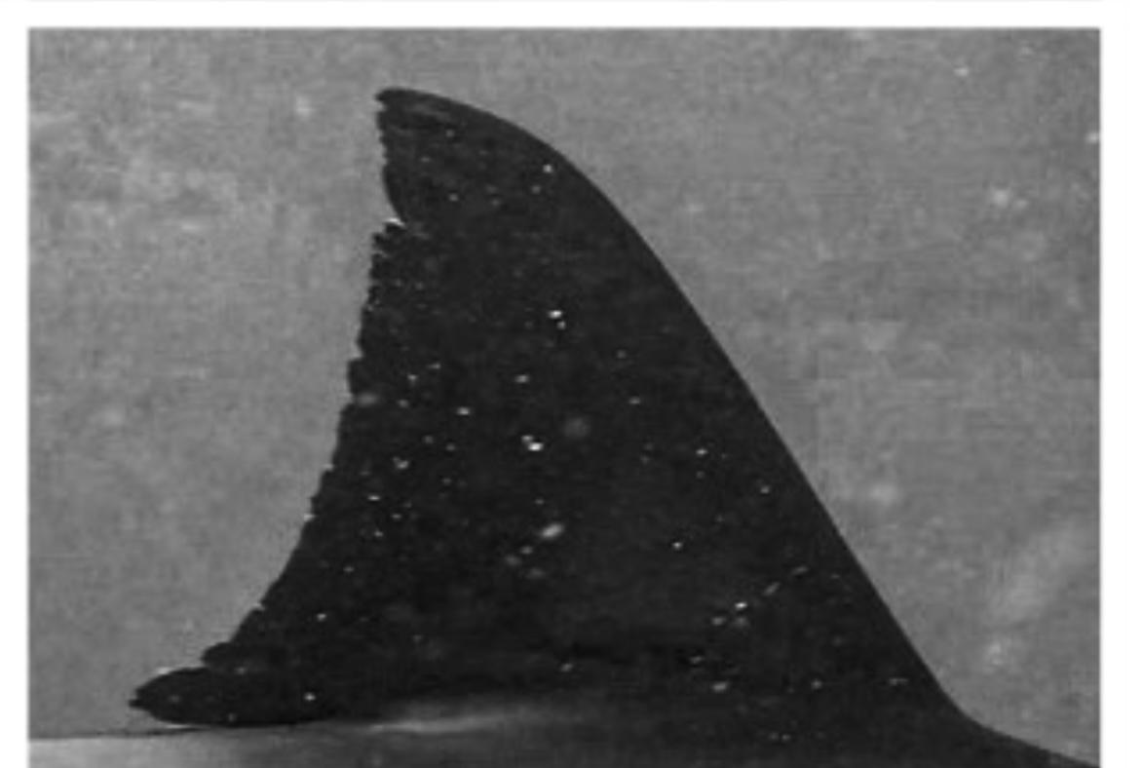
Notes:
JELLYBEAN

Slide 13
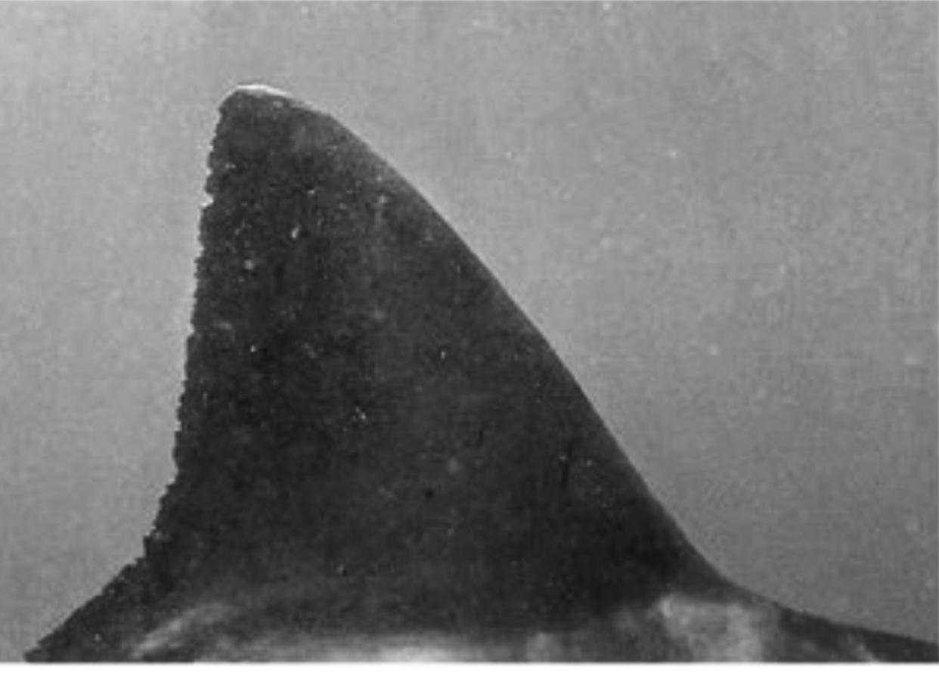
Notes:
TURBO

Slide 14
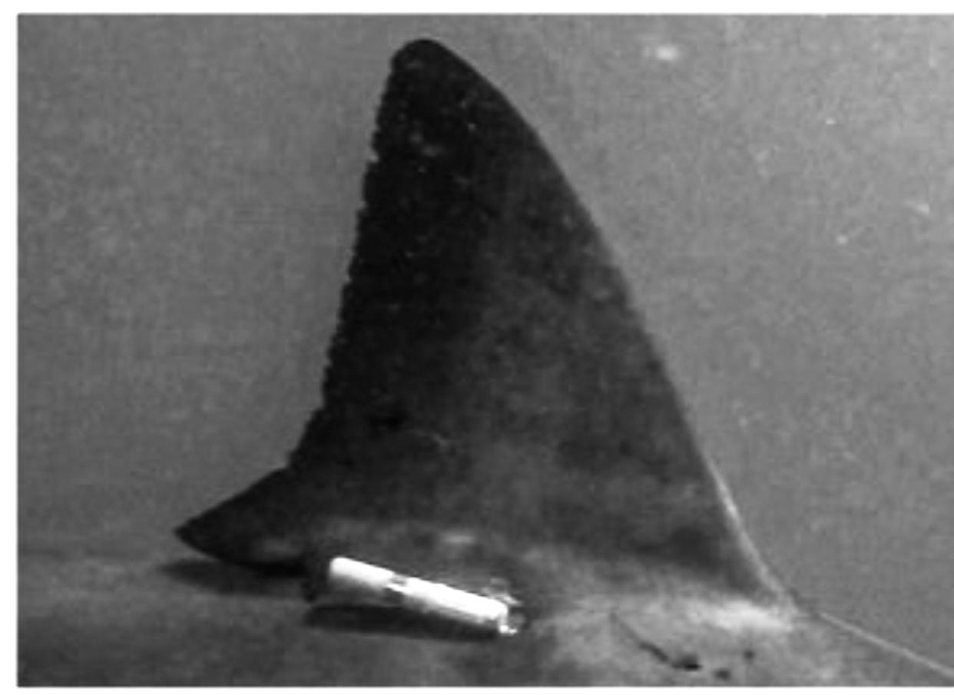
Notes:
TURBO

Slide 15
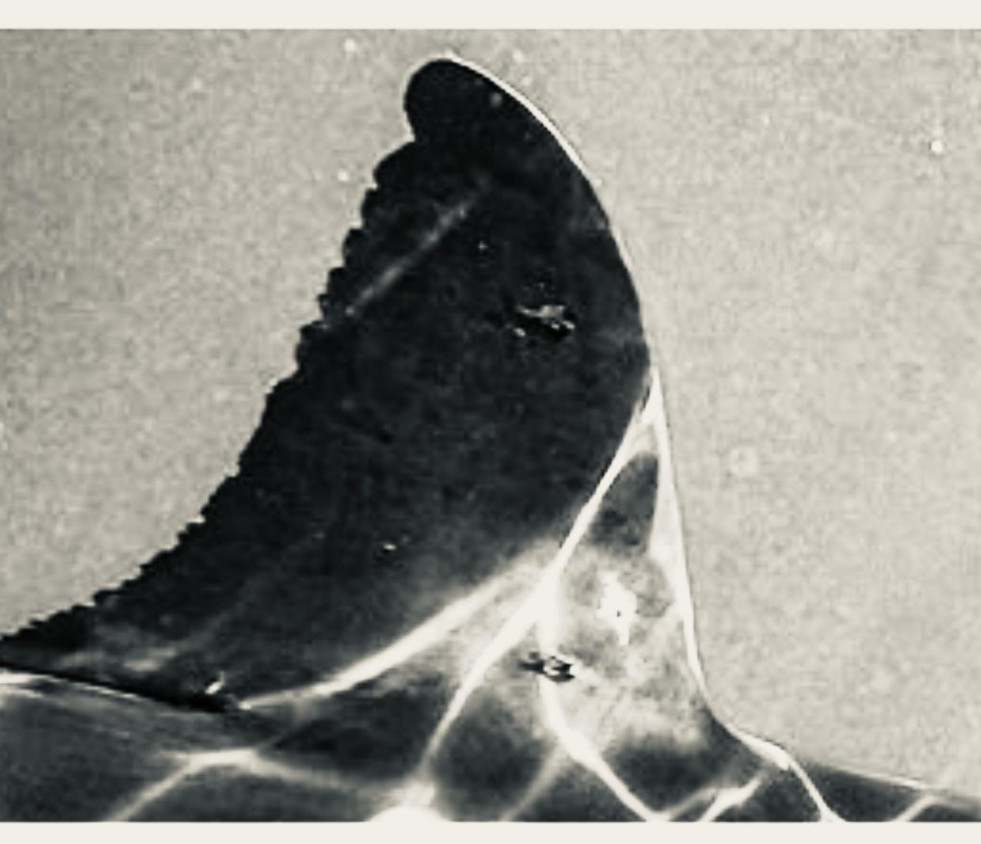
Notes:
SHARKUTERIE

Slide 16
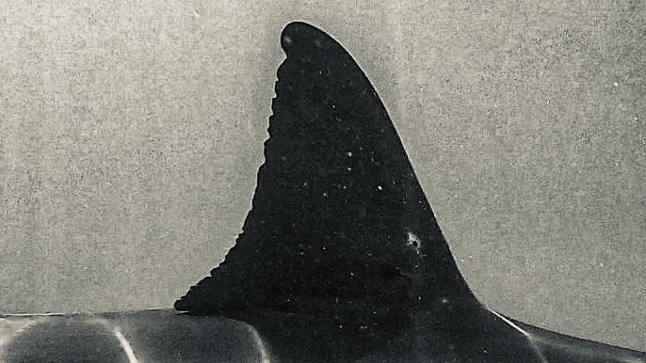
Notes:
SHARKUTERIE

Slide 17
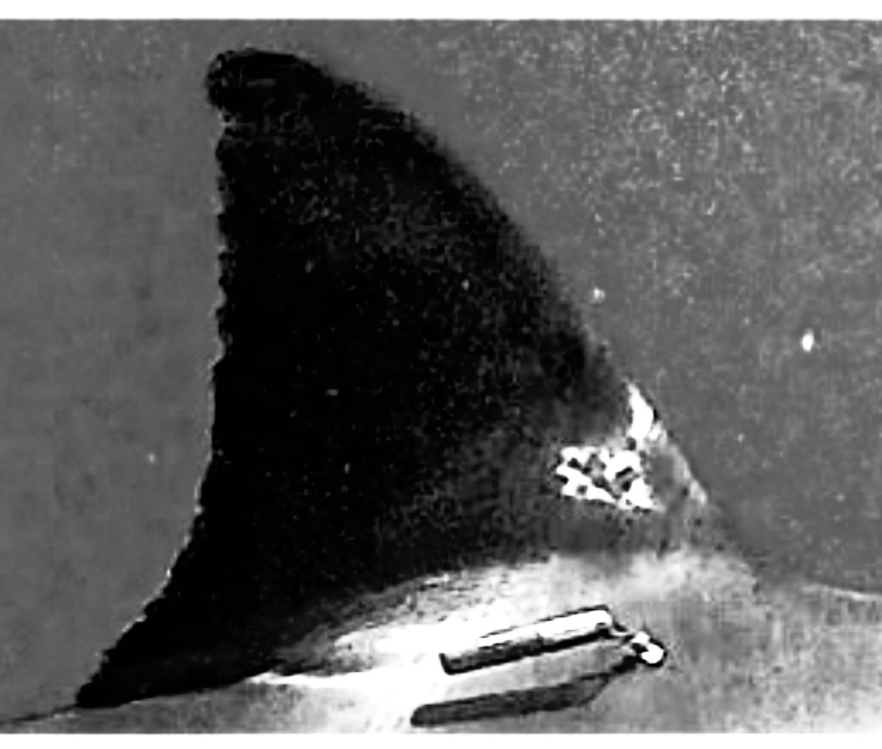
Notes:
SHARKUTERIE

